Slide 1

Predicting the appropriate locations for a stationery business

Slide 2
Predicting places for the implementation of a stationery
In a business model, it is necessary to evaluate some areas that interfere with the implementation:
Competition - check the area to see if there are many businesses in the same industry there
Opportunity - who will be like people and institutions to buy with your future business
Locality - best place to invest in a new establishment
Good movement of people around the place

Slide 3
Data acquisition and cleaning
Number of schools in the neighborhood
Number and distance of stationers in the neighborhood, if any
Distance from the neighborhood to the central point located in Maracanã
The number of schools, names, their type and location in each neighborhood will be obtained using the Foursquare API
The number of stationers, names, their type and location in each neighborhood will also be obtained using the Foursquare API

Slide 4
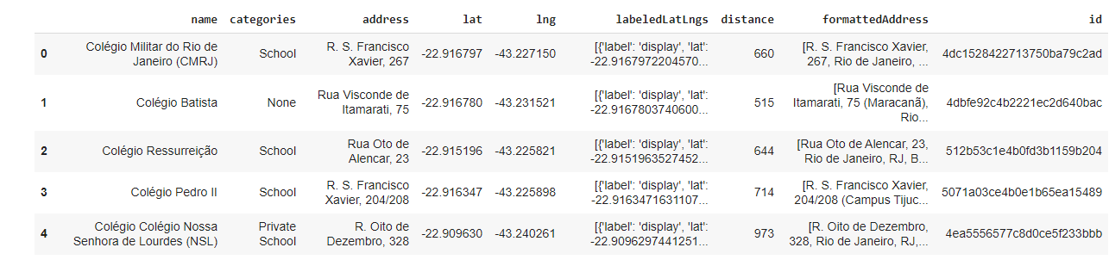
Data frame of schools close to the central point

Slide 5
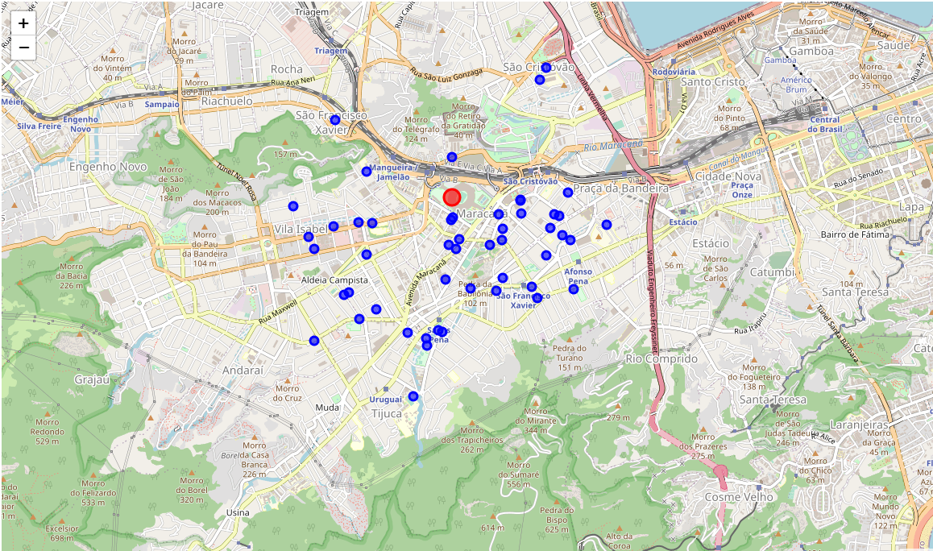
Points where colleges are located on the map

Slide 6
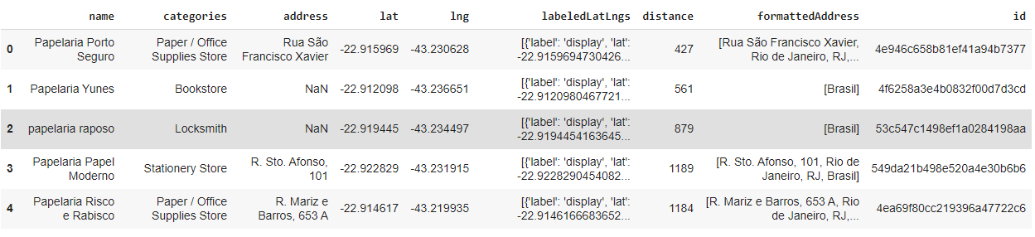
Data frame of stationers near schools in the region

Slide 7
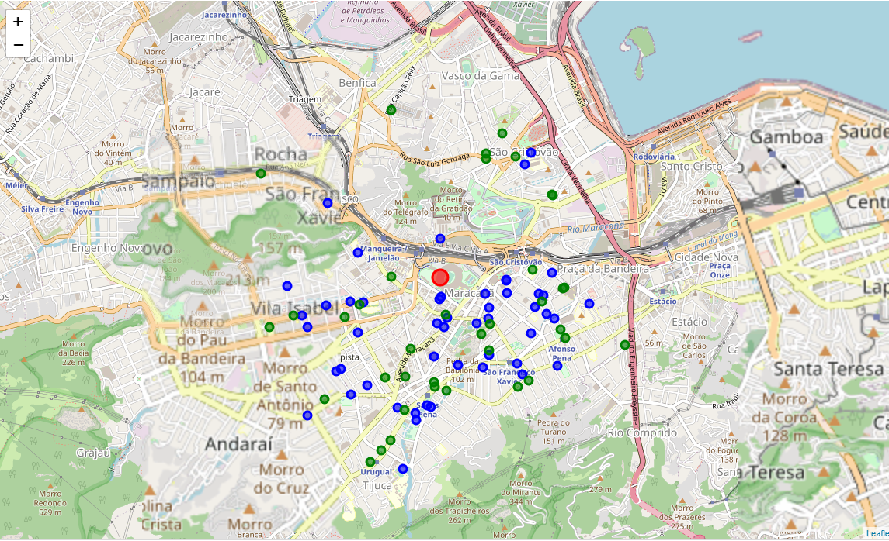
Distribution of schools and stationery stores after the addition of two data frames
First step was to join the two data frames for the analysis;
The second step is to evaluate the data samples and their proportions on the graph;
Green points - Stationery in the area;
Blue points – Schools.

Slide 8
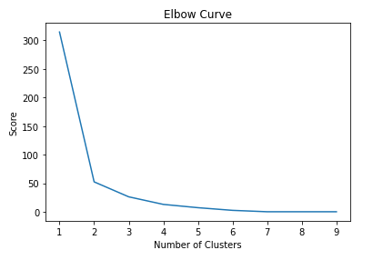
Analysis of K-Means clusters
The elbow method tries to solve the problem of the best choice of the ‘k’ argument.
So, in the problem we identified a “k = 2” being the best performance of the algorithm, so from it we can start the case study with K-Means

Slide 9
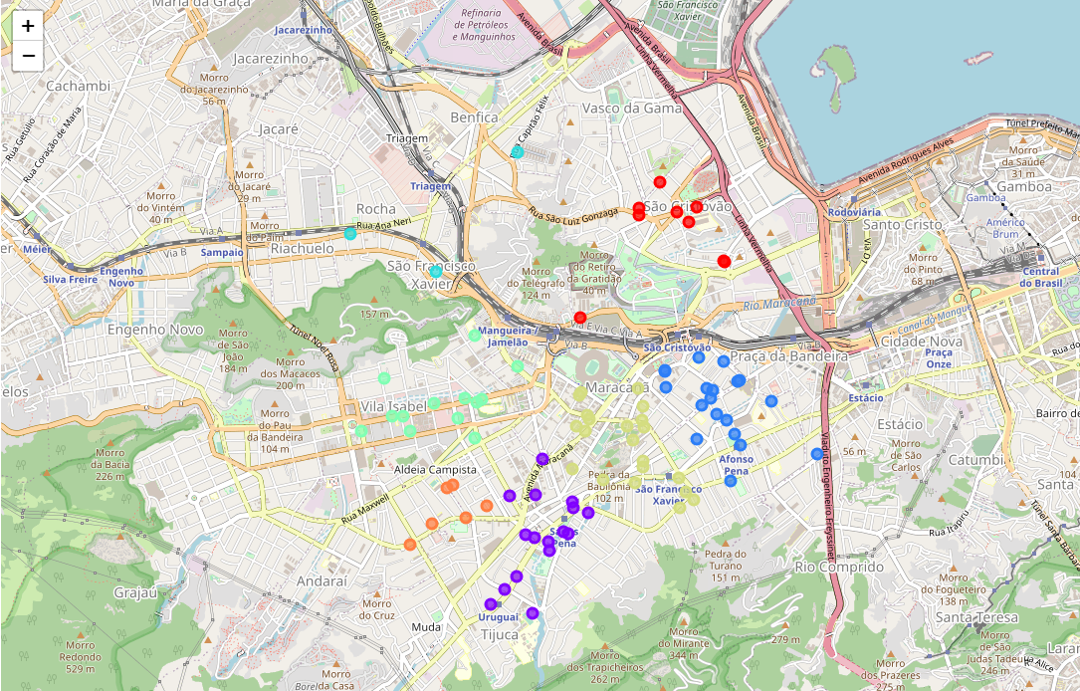
Graphical visualization of K-Means clusters
With k = 7 our graphical distribution occurred satisfactorily with precision over the grouped points.
We can see that the points away from the other clusters were left in new clusters.

Slide 10
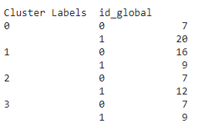
Numerical distribution of school clusters by stationery stores
The model used has large numbers of stationery stores near some schools, as well as distractions with few stationery stores and many schools.

Slide 11
Conclusion and future directions
The number of schools is higher in the regions of Maracanã, São Cristovão and Vila Isabel.
In these three areas there are few stationery stores for many schools
In other locations on the map, many stationers are grouped
Ideas include:
Include in the analysis data from other establishments that use the services of the proposed business.

